Slide 1
Project Presentation and Demonstration
Team Name: Swinburne Software Group
Group no: 04
Members: 06

Slide 3
Table of Content
Introduction
Design Idea 1 - Comprehensive Ion Exchange System For Nitrate Removal
Design Idea 2 -
Design Idea 3 -
Design Idea 4 -
Design Idea 5 -
Design Idea 6 -
Justification

Slide 4
Jigalong (Introduction)
A little town called Jigalong can be found in Western Australia's Pilbara area.
The Jigalong people are part of the Martu Aboriginal group, which is one of the Indigenous Australian groups
The Martu Wangka language, also known as Martu Wangka or Wangka Maya, is used by the Jigalong people, members of the Martu Aboriginal tribe, to communicate.
The Martu culture is heavily rooted in cultural traditions and celebrations. These rituals serve a variety of purposes, and typically include components like singing, dancing, and storytelling.
About 427 people live in the isolated Aboriginal village of Jigalong.
Jigalong has to deal with the problem of contaminated water. The main chemical problems influencing water quality are nitrates and uranium. They are frequently found in the Goldfields and Pilbara region and also have natural origins. High levels of nitrate and uranium can be dangerous to one's health. Nitrates pose a serious risk, particularly to infants, by reducing the blood's ability to carry oxygen. This can result in the potentially fatal illness known as Blue Baby Syndrome, which is marked by infants' bluish skin tones and breathing issues.

Slide 5
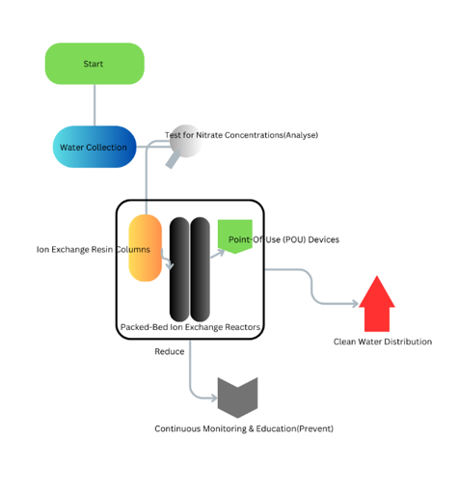
Design Idea 1 - Comprehensive Ion Exchange System For Nitrate Removal
Utilizes resin-filled columns, where resin beads selectively capture nitrates, effectively purifying the water as it flows through.
Initiation of the water treatment process.
Water to be sourced from local areas.
Nitrate levels are assessed.
Water flows through columns that contain resins, removing nitrates.
Used for treating large quantities of water using similar resin technology.
Final purification in households to ensure nitrate-free water.
Purified water is then distributed for community consumption
Regular checks on water quality and educating the community on water health

Slide 6
Design idea 1
Approaches:
Analyse: nitrate concentration in water using spectrophotometry.
Reduce: nitrate level using Ion exchange.
Prevent: continuous Water Quality Monitoring And Community Education.
Technology:
Ion Exchange
Uses resin beads to remove contaminants like nitrates, purifying the water in columns, reactors, and POU units
Devices:
Ion Exchange Resin Columns –
Built with high-quality materials resistant to corrosion, they play a pivotal role in reducing nitrates.
Packed-Bed Ion Exchange Reactors –
Featuring advanced valves and monitoring, these reactors guarantee consistent water flow and thorough purification.
POU Devices –
Precision-engineered for peak purification, they act as the final barrier between impurities and the community.

Slide 7
Design idea 1
Benefits, Community Impact & Constraints
Benefits:
Improved Community Health.
Scalable Design For Future Needs.
Assurance Of Water Purity In Every Home.
Community Impact:
A Healthier Future With Reduced Nitrate Intake.
Education On Water Health For Community Empowerment.
Serving As A Model For Other Communities.
Constraints:
Need For Ongoing System Maintenance.
Initial Financial Investment ($150,000 to $200,000)

Slide 8
Design idea 2
Design idea (your own diagram explaining your concept)
Use dot points and images

Slide 9
Design idea 2
What are your three different approaches in different stages of your design?
What are your technologies and devices used in your design?
Use dot points and images

Slide 10
Design idea 2
Explain your design benefits, impacts and constraints clearly
Use dot points and images

Slide 11
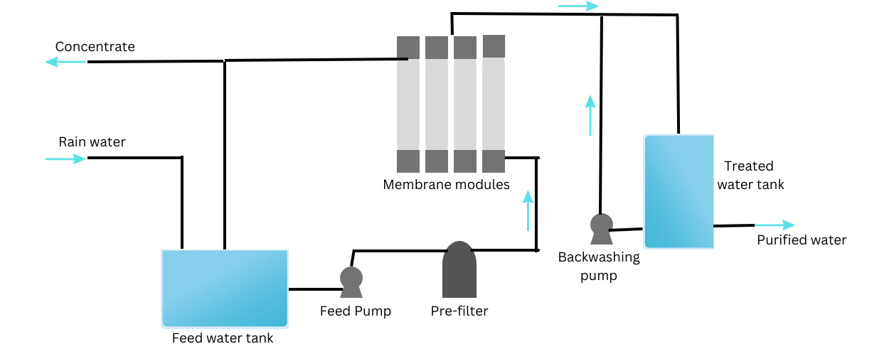
Design idea 3- Ultrafiltration
Utilizes semi-permeable membrane to allow only selective components to pass through, leaving impurities like nitrates at the surface of membrane and provide clean drinking water.
Water sourced from nearby areas
Water stored in feed water tank for purification
Water to be pre-filtered prior to passing it to ultrafiltration membranes
Impure water passes through semi-permeable membranes
Purified water stored in a clean water tank and sent to households
Certain amount of purified water passed back to membranes modules to remove the impurities from membranes

Slide 12
Design idea 3
Approaches:
Reduce: nitrate level in water using semi-permeable membrane.
Eradicate: many impurities including nitrate using semi-permeable membrane.
Prevent: effective monitoring can prevent water contamination.
Technology used:
Control and automated systems- Software monitor to manage ultrafiltration automatically. Includes devices like sensors and controllers.
Data analytics and AI- Analysis of ultrafiltration operation parameters like flow rates, backwashing schedules, chemical dosing rates and also predict maintenance required using AI.
Backwashing systems- Removal of impurities, stuck at the surface of membrane during ultrafiltration, by reverse flow of water into membrane modules.
Transmembrane pressure control- regulates pressure difference across membranes

Slide 13
Design idea 3
Benefits, Community Impact & Constraints
Benefits:
Access to safe drinking water.
Space efficient.
Minimal usage of chemical additives.
Community Impact:
Reduced water wastage, contributing to water conservation.
Environmental beneficial due to reduced usage of chemicals.
Improved water quality.
Constraints:
Frequent maintenance required for membranes.
Due to constant accumulation on membrane, membrane performance is affected
Cost of installment:
Residential installment- approx. AUD 1,500 to AUD 5,000
Commercial installment- approx. AUD 5,000 to AUD 20,000

Slide 14
Design idea 4
Design idea (your own diagram explaining your concept)
Use dot points and images

Slide 15
Design idea 4
What are your three different approaches in different stages of your design?
What are your technologies and devices used in your design?
Use dot points and images

Slide 16
Design idea 4
Explain your design benefits, impacts and constraints clearly
Use dot points and images

Slide 17
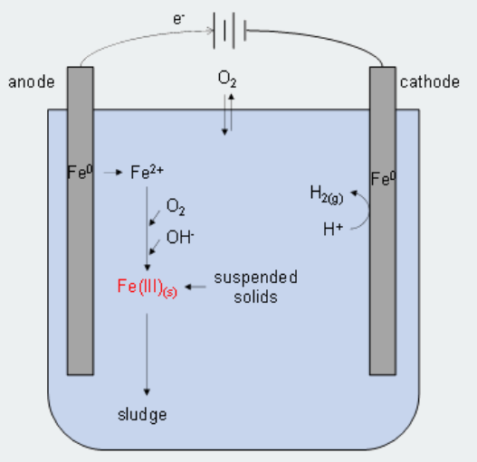
Design idea 5 - Advanced Electrocoagulation Process for Multi-Contaminant Removal.
By using electrodes to neutralize pollutants, the electrocoagulation water treatment method effectively and sustainably cleanses water, providing the community with safe and clean drinking water.
Initiation of the electrocoagulation process
Assessment of Water quality
Electrocoagulation process
Contaminant removal from metal ions
Filtration and Separation
Final purification in households
Community distribution
Quality monitoring
Janaka Muthunayake

Slide 18
Design idea 5
Approaches:
Analyse: Analytical Testing for Contaminant Profiles.
Reduce: Contaminant-Specific Electrocoagulation Parameters.
Prevent: Source Protection and Conservation Practices
Technologies and devices used:
Electrodes and Electrochemical Reactions: Electrodes, made of materials like aluminium or iron, facilitate electrochemical reactions, releasing metal ions into water when an electrical current is applied, destabilizing and neutralizing contaminants.
Water Quality Monitoring: Technology continuously monitors parameters like pH, turbidity, and conductivity in water, enabling immediate adjustments to treatment processes based on real-time data.
Settling Tanks and Flotation Units: Physical separation of coagulated particles from treated water is achieved through the use of flotation units, which introduce air bubbles to facilitate their removal.
Filtration Systems: Membrane filtration and filter media are essential methods for contaminant removal in water, ensuring the efficient and clean treatment of water.
Janaka Muthunayake

Slide 19
Design idea 5
Benefits, Community Impact & Constraints
Benefits:
Access to safe drinking water
Improved water quality
Cost effective water treatment
Community Impact:
Reduce environmental impact
Sustainable water treatment
Health and safety enhancement
Constraints:
Energy consumption and cost
Maintenance requirements
Sludge management
Janaka Muthunayake

Slide 20
Justification
The team must explain clearly why and how each design is justified based on your data in the table below

Slide 21
Thank you

